Slide 1
M7 Student Pass Project Update
Ehab Ebeid, MCP1 MIT Transit Lab
16 October 2019 MBTA

Slide 2
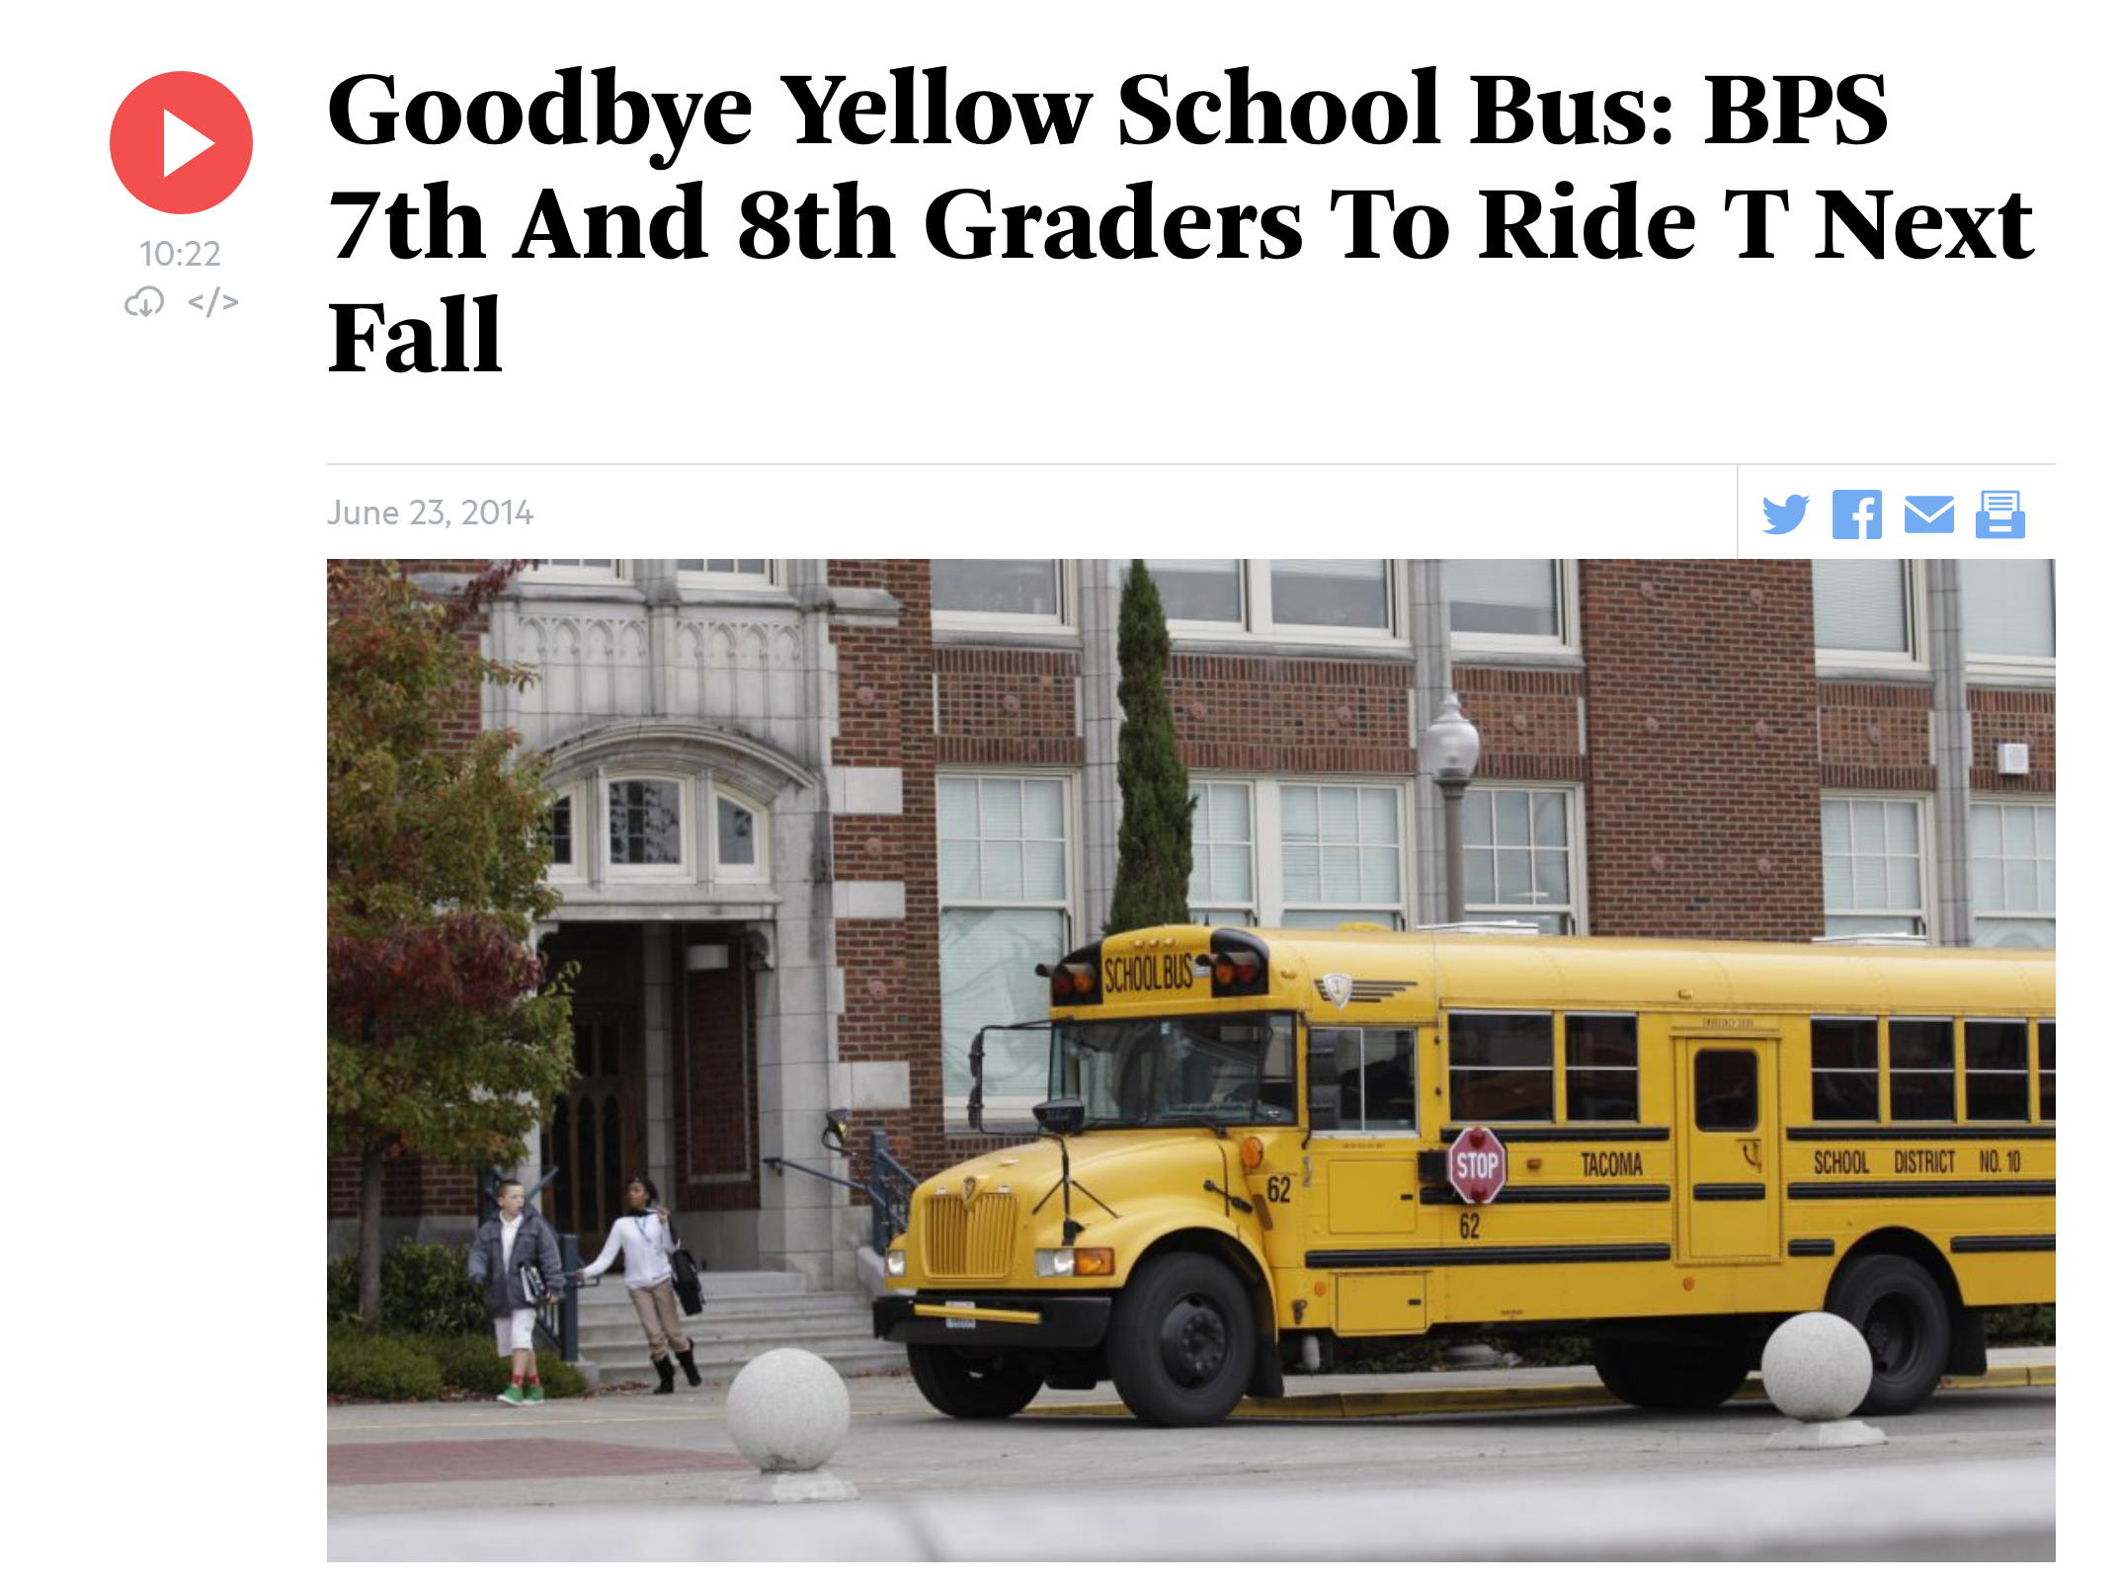
Contents
Trips
Schools
Trips and Schools
WBUR/Ted S. Warren/AP

Slide 3

Trips
Retrieving, aggregating, and exploring the journeys of BPS CharlieCard holders.

Slide 4
Joins to Retrieve Stages
ODX
BPS
GTFS (d)
GTFS (o)
Card Hash
Origin Stop Code
Dest. Stop Code

Slide 5

From Stage to Journey
Card | Type | Tap Time | Journey | Stage | Origin | Origin Y | Origin X | Dest. | Dest Y | Dest X
007BxvQ ... | m7 | 12/09/2018 07:05 | 1 | 1 | Morton St @ Evans St | 42.280886 | -71.084654 | Forest Hills | 42.300479 | -71.11363
007BxvQ ... | m7 | 12/09/2018 07:31 | 1 | 2 | Forest Hills | 42.300523 | -71.113686 | ? | ? | ?
Card | Type | Tap Time | Journey | Origin | Origin Y | Origin X | Dest. | Dest Y | Dest X
007BxvQ ... | m7 | 12/09/2018 07:05 | 1 | Morton St @ Evans St | 42.280886 | -71.084654 | ? | ? | ?

Slide 6
ODX Data Filtering
Query: From Sep 1, 2018 to latest. Origin is not null.
Stages: 11 million rows
Journeys: 7.7 million rows
School-year only (6 Sep 2018 to 19 June 2018): 7.1 million rows
Weekdays only: 6.3 million rows
M7 Cards only: 5.8 million rows
Excluding holidays, vacations and early release days: 5.4 million rows

Slide 7
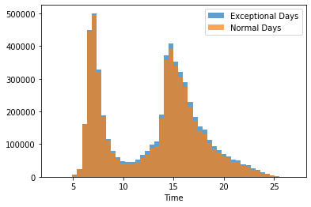
Trip Distribution

Slide 8
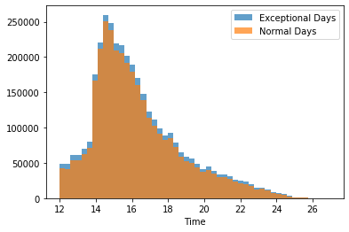
PM trip data is more useful

Slide 9

Schools
How are the schools divided and where are they located?

Slide 10
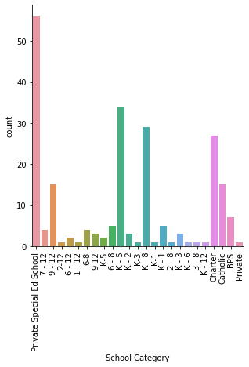
Schools
Notes:
So far the schools are not taken into consideration.

Slide 11
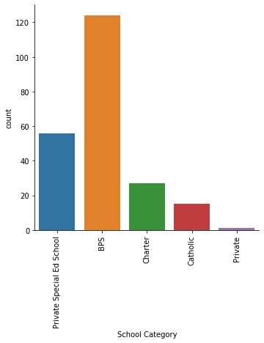
Schools
Notes:
Collapsing Categories

Slide 12
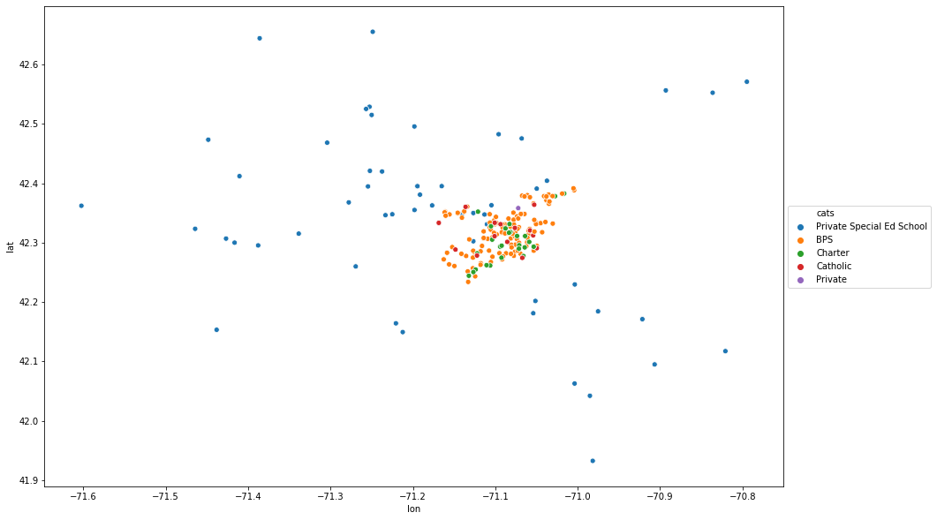
Schools

Slide 13
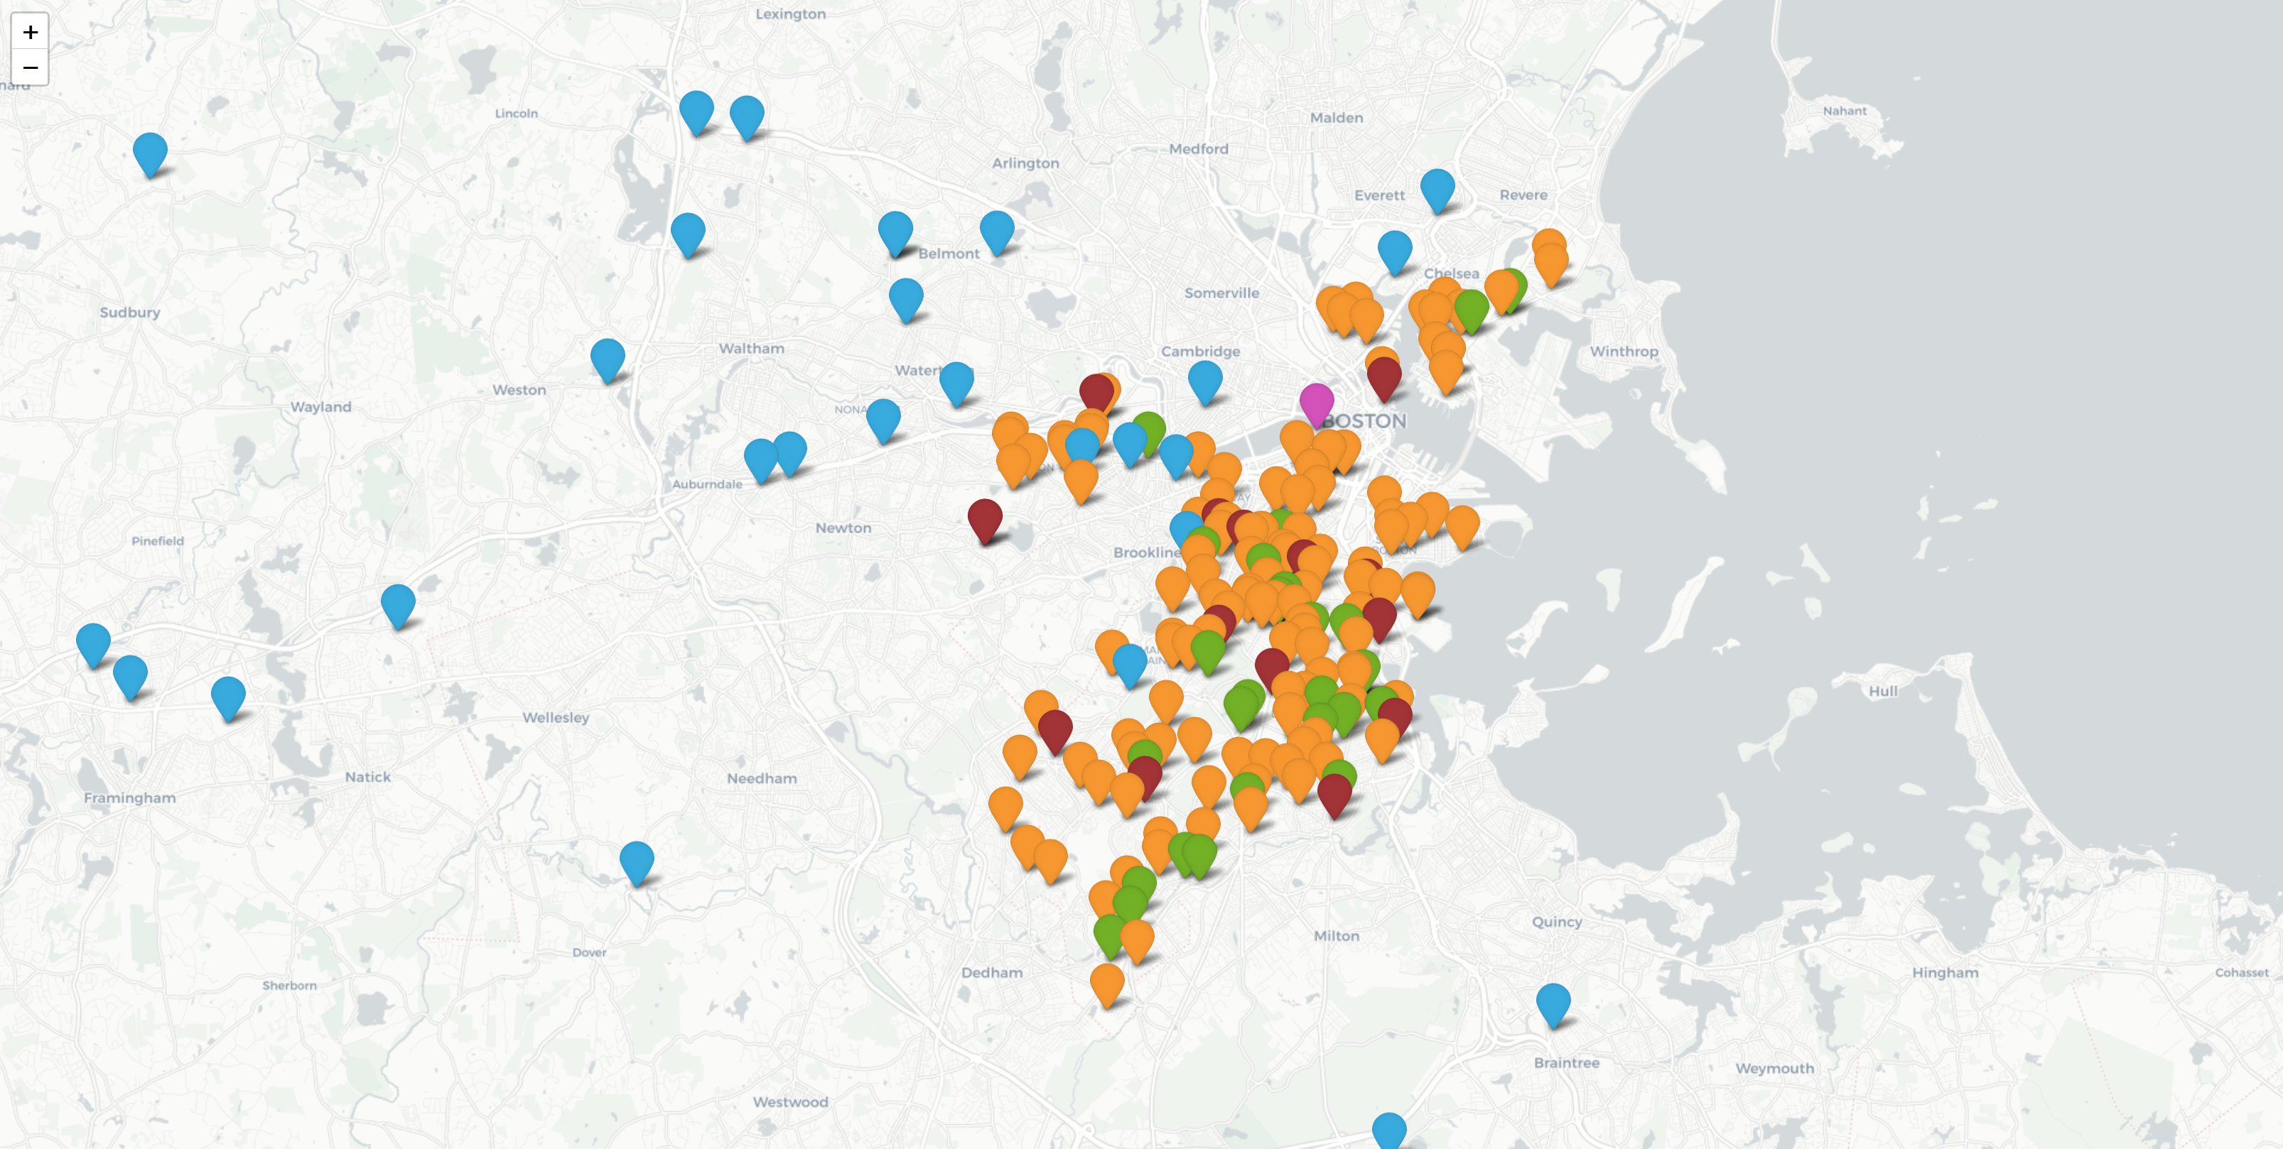
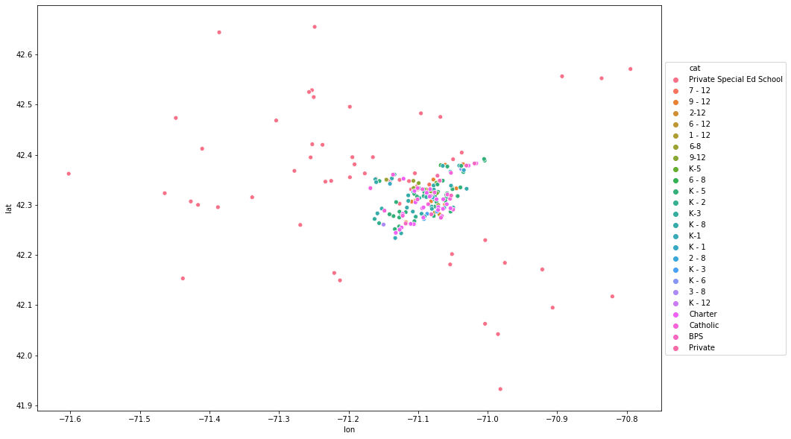
Schools
Private Special Ed
BPS
Charter
Catholic
Private
Notes:
Limit to BPS Schools

Slide 14
Trips and Schools
Combining trips and schools, switching to a card view, and preliminary results

Slide 15
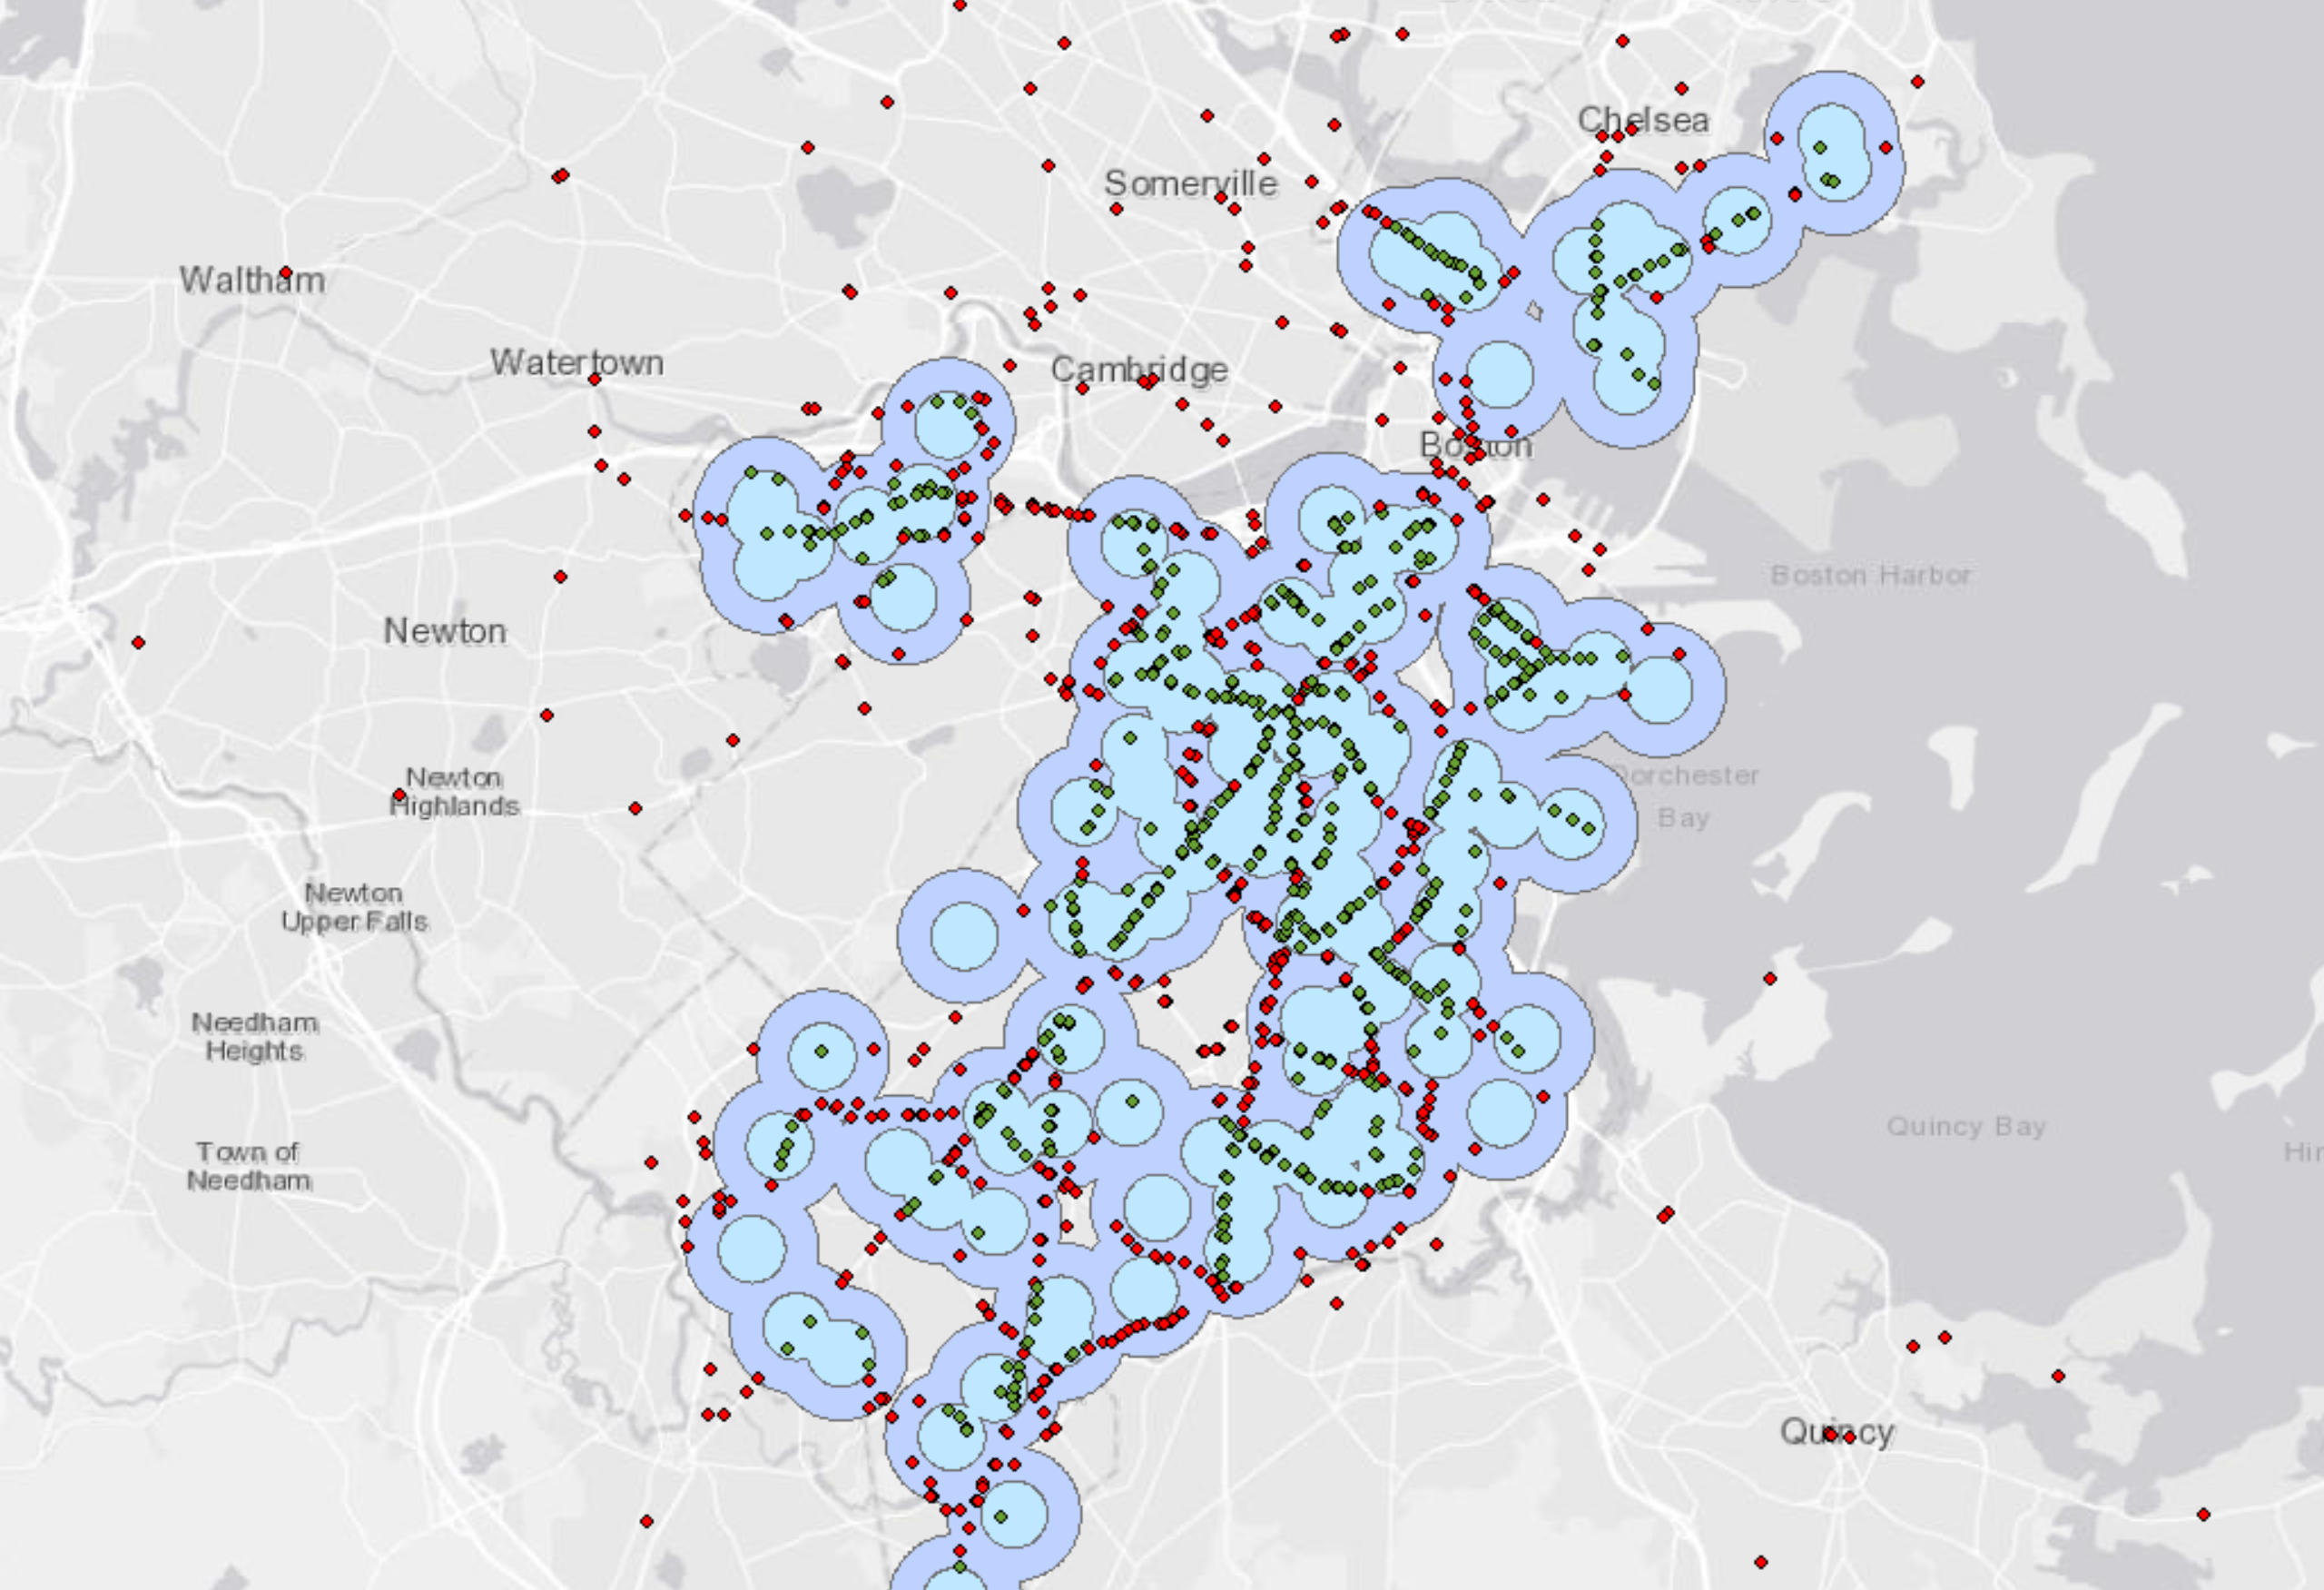
Buffers around schools
Notes:
This map shows a sample of 10,000 points only. Some points are overlapping.
The question of how wide it should be. Decided on 0.25 miles for now.

Slide 16
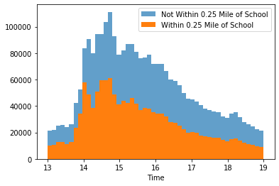
Trip distribution by buffer result
Out of 2.75 million journeys between 1 and 7 pm on ‘normal’ days:
1.39 million are within 0.25 miles of a BPS school.
1.36 million are not.

Slide 17
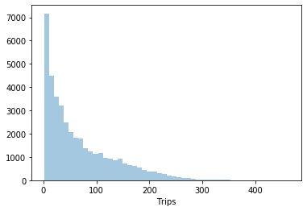
The view by card
40,586 unique cards
Mean: 68 trips
Std dev: 66 trips

Slide 18
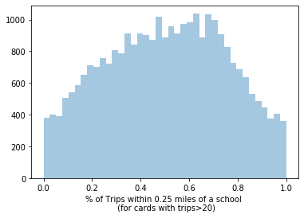
Card distribution by buffer result
Is 0.25 miles too conservative? Would 0.5 miles capture too many non-school trips?

Slide 19
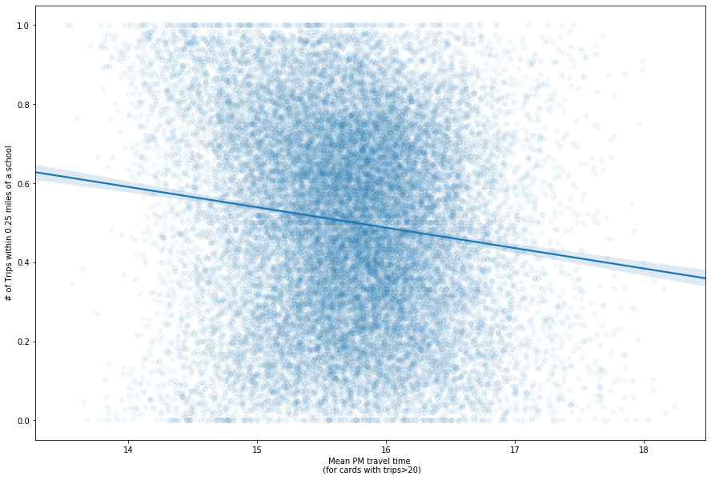
Are tap time and proximity to schools correlated?
A slightly negative correlation between the probability that a given card taps near a school and the average time of that same card’s taps.
99.99% confidence interval is shown.

Slide 20
Classifying Cards
 | Mean tap time before 5 pm | Mean tap time after 5 pm
Half of taps or more near a school | 50.95% | 0.91%
Less than half of taps near a school | 46.73% | 1.4%
Out of 28,471 cards with 20+ trips

Slide 21

Conclusions
Vast majority of cards’ PM travel is consistent with school schedules.
98% of cards have a mean tap time before 5 pm.
68% of cards have a mean tap time before 4 pm.
The mean tap time is 3:42 pm with a ~38 minute standard deviation.
Proximity to school more difficult to measure and overall less certain.
0.25 mi buffer might be too restrictive, but 0.5 mi covers most of the city centre.
Uncertainty as to which schools should be included in buffer.
52% of cards tap half the time or more within a quarter mile radius of schools included in analysis.
Potential future steps:
Get more specific about geographic criteria.
Clustering of cards based on spatiotemporal variables.
Jupyter Notebook tinyurl.com/yywu475m

